Slide 1
Hello

Slide 2
Here are some ideas to help you!

Slide 3
As children develop, control and stability begins at the trunk, progressing to the elbow, wrist and finally the hand.

Slide 4
START BIG
To support confident writing. We begin by strengthening the ‘trunk’ of the body. Having a strong core helps with posture and will support the arm and wrist.
Big arm movements! Wash the windows, stretch, lift, push…
Big chalk patterns on the floor.
Wheel barrow races.
Dancing.
Balancing.
Lay on tummy to write/draw/colour in.

Slide 5
Work out and Exercise!
These exercises are for developing upper body strength (shoulders) and core stability:
Spend sustained periods of time lying on the tummy whilst doing various activities
Crawling on fours at different speeds, forwards and backwards pushing a ball in front of them
Kneeling – balance on two knees, walk on two knees, throw and catch a ball whilst on two knees
Throwing – over the head two handed, from the shoulder one handed, shooting a ball through a netball net
Pull – ups at monkey bars
Pushing other children on wheeled toys (uphill and over rough terrain)
Set up a tug of war competition
Making snowballs out of scrunched up newspaper and using them to have a snowball fight (place a bench between 2 teams and challenge them to throw as far as they can across the bench at the other team)
Wheelbarrow races
Lifting and carrying heavy items such as buckets filled with soil or water, heavy shopping bags, heavy rocks or stones

Slide 6
Then go small
Fine motor skills involve the use of the muscles in the hands. Fine motor skills often require coordinating movements of the hands and fingers with the eyes; this called hand-eye coordination.
Threading: Could use beads or pasta on a string or practise tying your shoelaces.
Throw a box of pom poms in the air and use a peg to pick them all up.
Loom bands or elastic bands! Stretch and pull.
Popping bubble wrap! Endless fun.
Play and create with playdough, pressing, and manipulating the dough is a fantastic workout.
Have a go at a DOUGH DISCO, play upbeat music and dance your fingers into the putty.
Practise scissor cutting skills. You could cut along a pattern or cut around your pictures.

Slide 7
Work out and Exercise! Fine Motor Exercises
Chair Pushups – whilst sitting on a chair, curl hands around the sides of the chair and push off the seat (bottom and feet off the ground). Hold this position for 3-5 seconds and repeat for the same number as their age
Shoulder Shrugs – with palms facing upwards raise the shoulders to the ears, then release. Repeat 10-15 times
Hand Fist – Make a fist with both hands. Open and close the hands 10-15 times
Desk Pushups – in a standing position put hands flat on a table. Bend the elbows and raise and lower the chin like a press up. Make sure the elbows are bent and straightened each time
Pushing Palms – place both palms together and push as hard as possible
Spider Legs – place both hands on a flat surface. In turn lift each finger off the table in turn. It is very important to isolate each finger and lift one finger at a time
Pickups – pick up a small object (e.g. pea) with the fingers and “hide” it in the hand. Use the same fingers to keep picking up the objects and store them in the hand
Finger Football – scrunch up a tiny piece of tissue paper (the ball) and use one finger at a time to “kick” the ball
Pencil Aerobics – while holding the pencil bend and straighten the fingers; walk the fingers up and down the shaft of the pencil while holding it; while holding the pencil make the tip do circles in the air; place the pencil on the palm of the hand and roll the pencil to the fingertips and back

Slide 8
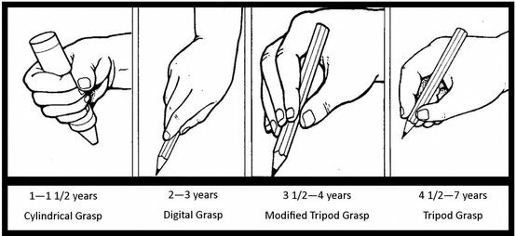

Slide 9
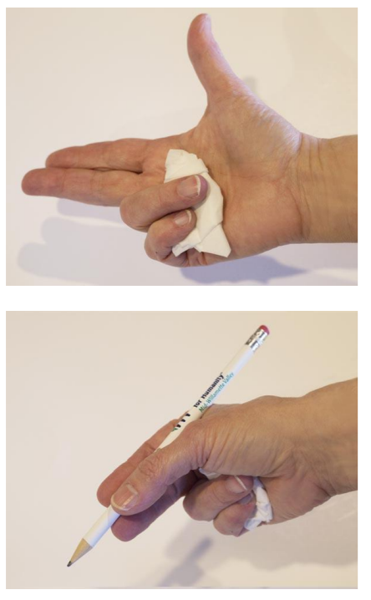
POWER OF THE POM POM
You may find it helpful to tuck a small pom pom inside the palm to encourage a tripod grip if appropriate.

Slide 10
Name writing and patterns.
Use this time to ensure your child is writing their name correctly. Writing their name gives them ownership of their work and a confidence boost.
Before writing letters, can your child copy patterns carefully. Important patterns to learn are the ‘o and +’ (start at the top and go anti clockwise for ‘o’ and up, down, left to right for ‘+’.
You could practice pencil control by filling in squared paper with circles and crosses. They might find it relaxing.

Slide 11
Practise letter movements
The correct letter movement is what counts, not just producing a neat letter. Children get better at producing letters by practising letter movements: big letters on walls; little letters in shaving foam; letters in sand, jelly and on paper. Rainbow letters with several colours and random patterns of letters are all good practice. Practise saying letter names with the letter movement to build that association. Watch your children write and check their movements, not their neatness.
Rainbow letters, go over in different colours. Using a template

Slide 12
Practise letter movements
Look at the letter.
Look at the Ruth Miskin rhyme. “around the apple and down the leaf”
Skywrite with both hands. That means draw it big using the whole body standing up and move the arms around following the rhyme. (Big movements will help the brain with hand eye coordination)
Write the letter on different surfaces with finger. You could use your thigh, palm/in a tray of sugar granules
Have a go with a pencil and paper

Slide 13
Small Steps
You could break it down into smaller steps and practise different groups of letters at a time.
Curly caterpillars letters
Long ladder letters
One armed robot letters
Zig Zag monster letters
These groups of letters follow the same starting pattern.

Slide 14
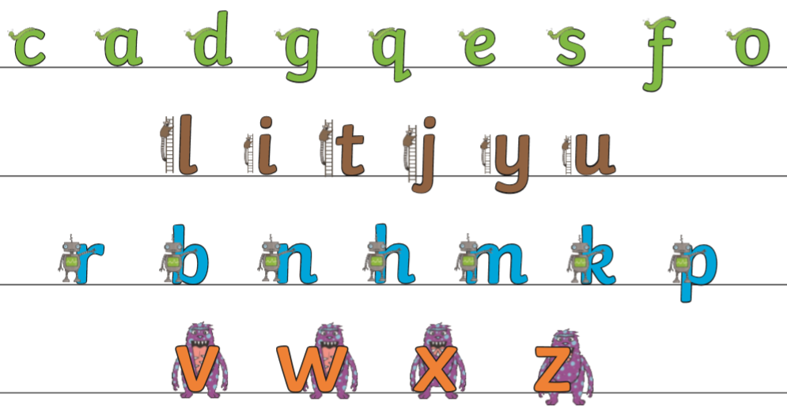

Slide 15
Reward all writing
Children need to build confidence in their writing ability; make sure you nurture this early on with positive feedback. Display their writing on a wall that reflects good effort or achievement. Respond to the content of what children write to send the message that writing is important. Build positive feelings about the act of writing, wanting to write and, through this, learning how to control a pencil (or chalk, pen, or paintbrush).

Slide 16
Reward all writing
It’s all about the small wins. When you child is showing confidence with writing. You could introduce a “two stars and a wish”, two stars focus on two things they have done really well and the wish is their one next step. Always talk to them about their next step.
For example,
“next time we are going to think about finger spaces”
“next time lets use small dots on the letter ‘i’”
“next time we are going to think carefully about forming the letter ‘g’”

Slide 17
REMEMBER
Don’t get hung up on their spellings.
We want them to use their phonics knowledge independently
Their words might look like this.
Blue = bloo
Chicken = chikn
Cars = kars
Salt = sowlt

